Slide 1



Distributed Graph Coloring on Multiple GPUs
SAND2020-10981 C
Ian Bogle - RPI/Sandia National Laboratories
Erik Boman, Karen Devine, Siva Rajamanickam – Sandia National Laboratories
George Slota - RPI
We thank the Center of Computational Innovations at RPI for maintaining the equipment used in this research, including the AiMOS supercomputer supported by the National Science Foundation under Grant No. 1828083. This research was also supported by the Exascale Computing Project (17-SC-20-SC), a collaborative effort of the U.S. Department of Energy Ofﬁce of Science and the National Nuclear Security Administration. Sandia National Laboratories is a multimission laboratory managed and operated by National Technology and Engineering Solutions of Sandia, LLC., a wholly owned subsidiary of Honeywell International, Inc., for the U.S. Department of Energy’s National Nuclear Security Administration under contract DE-NA-0003525.

Slide 2
Main contributions and results
We present the first distributed memory multi-GPU graph coloring implementation, to our knowledge
Our distributed distance-1 coloring implementation sees up to a 28x speedup on 128 GPUs over a single GPU, and only a 7.5% increase in colors on average
Our distributed distance-2 coloring implementation also sees up to a 28x speedup on 128 GPUs over a single GPU, and a 4.9% increase in colors in the worst case
Our approach is able to color a 12.8 Billion vertex mesh with 76.7 Billion edges in under half a second
We also present an approach that reduces the number of collective communications by increasing the cost of each communication.

Slide 3
Graph Coloring is Useful for Finding Concurrency
Computations with specific data access patterns can be parallelized with colorings
Compiler parallelization, register allocation
Preprocessing Jacobian and Hessian matrix computations
Also useful for finding short-circuits in circuit designs

Slide 4
Distance-1 Graph Coloring
Each vertex ends up with a different color from its neighbors.
Minimizing the number of colors used in the coloring is known to be NP-Hard.

Slide 5
Distance-2 Graph Coloring
A valid distance-2 coloring assigns each vertex a color not used by any vertex at most two edges away
Minimizing the number of colors used in the coloring is known to be NP-Hard.

Slide 6
Related Work
Coloring heuristics use few enough colors to be useful to applications
Two main parallelization approaches
  Jones & Plassmann (1993) uses independent sets to color vertices in parallel
  “Speculate & Iterate” approaches use heuristics in parallel and fix conflicts
    Gebremedhin and Manne (2000)
    More popular approach recently
Shared Memory & GPU Implementations
  Catalyurek et al. (2012) and Rokos et al. (2015) present shared-memory implementations
  Deveci et al. (2016) and Grosset et al. (2011) present coloring implementations on the GPU
Distributed approaches
  Bozdӑg et al. (2008) adapt the “Speculate & Iterate” approach in distributed memory, subsequent works (2010) include a distance-2 implementation.
  Sariyȕce et al. (2012) presents a hybrid MPI+OpenMP implementation.

Slide 7
We Leverage KokkosKernels to Run on GPUs
KokkosKernels is a package that implements various linear algebra and graph operations, using the Kokkos shared-memory parallel programming model
  https://github.com/kokkos/kokkos-kernels
The distance-1 graph coloring algorithms we use are described by Deveci et al. (2016)
The distance-2 graph coloring algorithm in KokkosKernels uses the same Net-Based approach described by Taç et al. (2017)
We vary the distance-1 algorithms based on how skewed the inputs are.

Slide 8
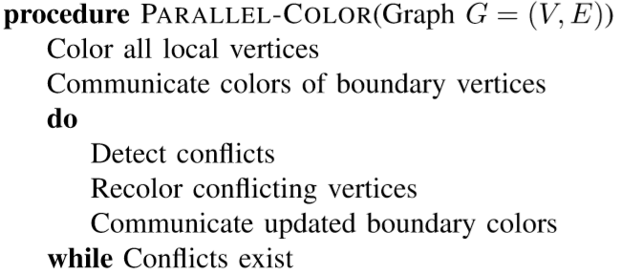
Distributed “Speculate and Iterate” Coloring
Based on Gebremedhin and Manne (2000)

Slide 9
Distributed Distance-1 Coloring
These ghost vertices are copies of the boundary vertices on other processes. They only have edges to local boundary vertices
These vertices are boundary vertices, because they neighbor ghosts
And repeat this process until no conflicts exist.
Then, communicate colors from boundary vertices to remote ghosts
We detect conflict consistently across processes
We color the local vertices on each process
!
!
!
!
!
!
!
!
!
!
!
!

Slide 10
Distributed Distance-2 Coloring
These vertices are boundary vertices in this context, they are at most two edges away from a ghost vertex
We add another layer of ghost vertices by copying the first ghost layer’s neighbors. Second layer ghosts only have edges to the first ghost layer
And repeat this process until no distance-2 conflicts remain
We do a local distance-2 coloring on each process
Communicate boundary vertices to ghost copies
Consistently detect distance-2 conflicts
!
!
!
!
!
!
!
!
!
!
!
!
!
!
!
!

Slide 11
Distance-1 with Two Ghost Layers (D1-2GL)
These ghosts will not change after the initial communication
These vertices cannot conflict with any ghosts
We detect conflicts consistently across processes
Each process can resolve conflicts independently, without communicating (in this example)
Process A
Process B
!
!
!
!
!
!
!
!
!
!
!
!

Slide 12
D1-2GL Aims To Reduce the Total Number of Collective Communications
Second ghost layer vertices can get recolored, in general
Local colorings need to make the same choices independently
Each communication costs more
  Ghosts can be on more than one process
  Each ghost copy also copies its neighbors
  Very expensive for dense inputs

Slide 13
Our Results Include Real and Synthetic Inputs
Our real inputs come from a variety of domains
  Including: PDEs, social networks, road networks
  Range in size from 0.9 M vtx, 21 M edges to 30 M vtx, 3.3 B edges
  Max degrees vary from 13 to 2.9 M
  Use XtraPuLP graph partitioner developed by Slota et al. (2017)
Our synthetic inputs are uniform hexahedral meshes
  Vary only one dimension to keep communication costs constant
  Partitioned in slabs
  Range in size from 12.5 M vtx, 75 M edges to 12.8 B vtx, 76.7 B edges

Slide 14
Experimental Setup
We performed tests on AiMOS, housed at RPI.
  268 nodes with 2 IBM Power9 3.15GHz processors
    4 NVIDIA Tesla V100 GPUs with 16GB of memory connected with NVLink
  Infiniband interconnect
  Compiled with xlC 16.1.1, and Spectrum MPI with GPU-Direct disabled
We run all experiments with 4 ranks per node
  On GPU runs each rank gets an exclusive GPU
  For performance profiles we use 128 ranks, or the largest run for which all approaches completed a run
Zoltan is a package of the Trilinos Library containing distributed combinatorial algorithms, has MPI-only distance-1 and distance-2 implementations
  http://cs.sandia.gov/zoltan
  Run with 4 ranks per node, no shared-memory parallelism

Slide 15
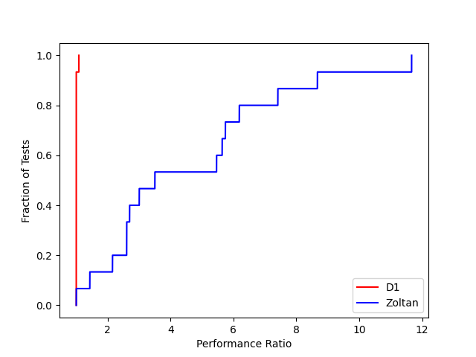
Distance-1 Runtime Performance Profile
Performance ratio can be thought of as how many times slower one approach is than the other
Our approach is only 8% slower for a single input.
Our approach is around 12x faster than Zoltan in the best case

Slide 16
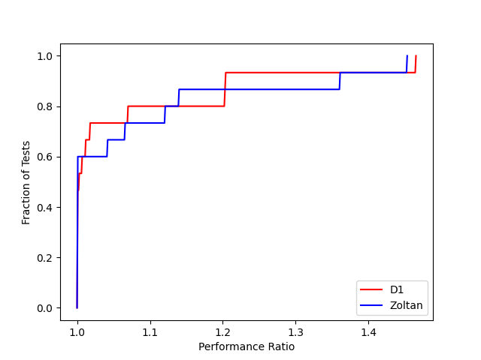
Distance-1 Color Usage Performance Profile
Zoltan uses fewer colors in 60% of the inputs
On average we use 6.8% more colors than Zoltan
In the worst case, Zoltan uses 46% fewer colors than our approach

Slide 17
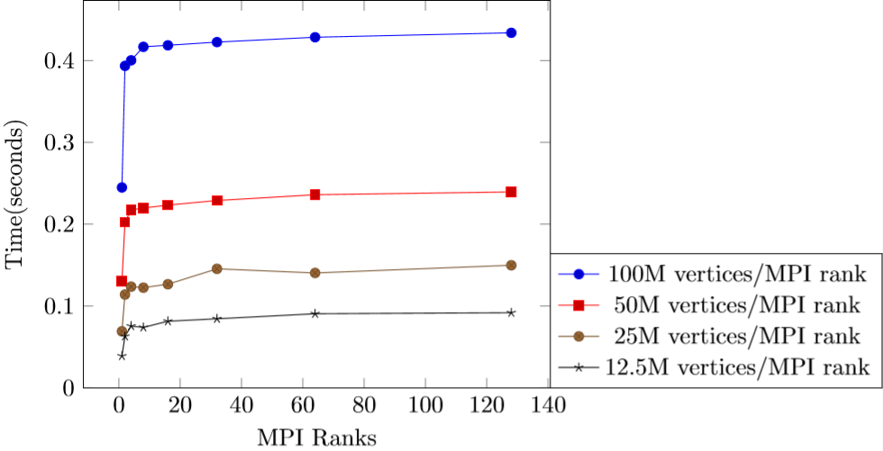
Distance-1 Weak Scaling
The largest input we ran has 12.8 Billion vertices and 76.7 Billion edges, which was colored in under half a second.
For each workload there is an overall time increase of about 10% from the 2 rank runs.

Slide 18
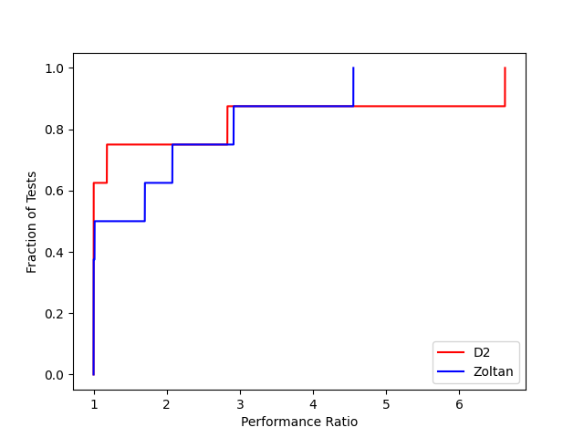
Distance-2 Runtime Performance Profile
We use a smaller set of inputs for these profiles
We are competitive with Zoltan for all but two inputs, which are highly skewed inputs.
Our approach sees at most a 4.5x speedup relative to Zoltan

Slide 19
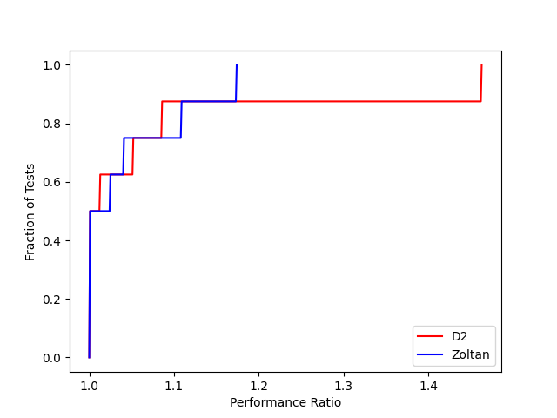
Distance-2 Color Usage Performance Profile
We are competitive with Zoltan on all but one input, where we use 46% more colors than Zoltan.
Our approach uses at most 10% more colors than Zoltan in all but one case

Slide 20
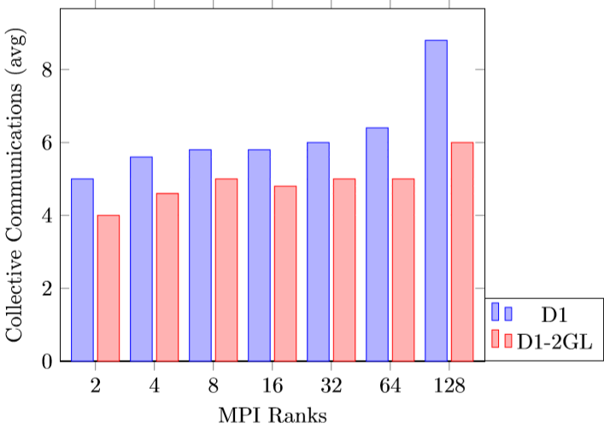
Two Ghost Layers Reduce the Number of Collective Communications
Unfortunately, this does not translate into speedup over D1

Slide 21
Future Work
Optimizing distance-2 communication
Extending our approach to solve different coloring problems
Exploring optimizations to D1-2GL communication

Slide 22
Main contributions and results
We present the first distributed memory multi-GPU graph coloring implementation, to our knowledge
Our distributed distance-1 coloring implementation sees up to a 28x speedup on 128 GPUs over a single GPU, and only a 7.5% increase in colors on average
Our distributed distance-2 coloring implementation also sees up to a 28x speedup on 128 GPUs over a single GPU, and a 4.9% increase in colors in the worst case
Our approach is able to color a 12.8 Billion vertex mesh with 76.7 Billion edges in under half a second
We also present an approach that reduces the number of collective communications by increasing the cost of each communication.
Contact Me: boglei@rpi.edu

